Slide 1
Learning Objective
I will be able to determine the period, amplitude, domain and range
Success Criteria
At the end of the lesson, I will be able to:
Determine the determine the period, amplitude, domain and range of tangent graphs

Slide 2
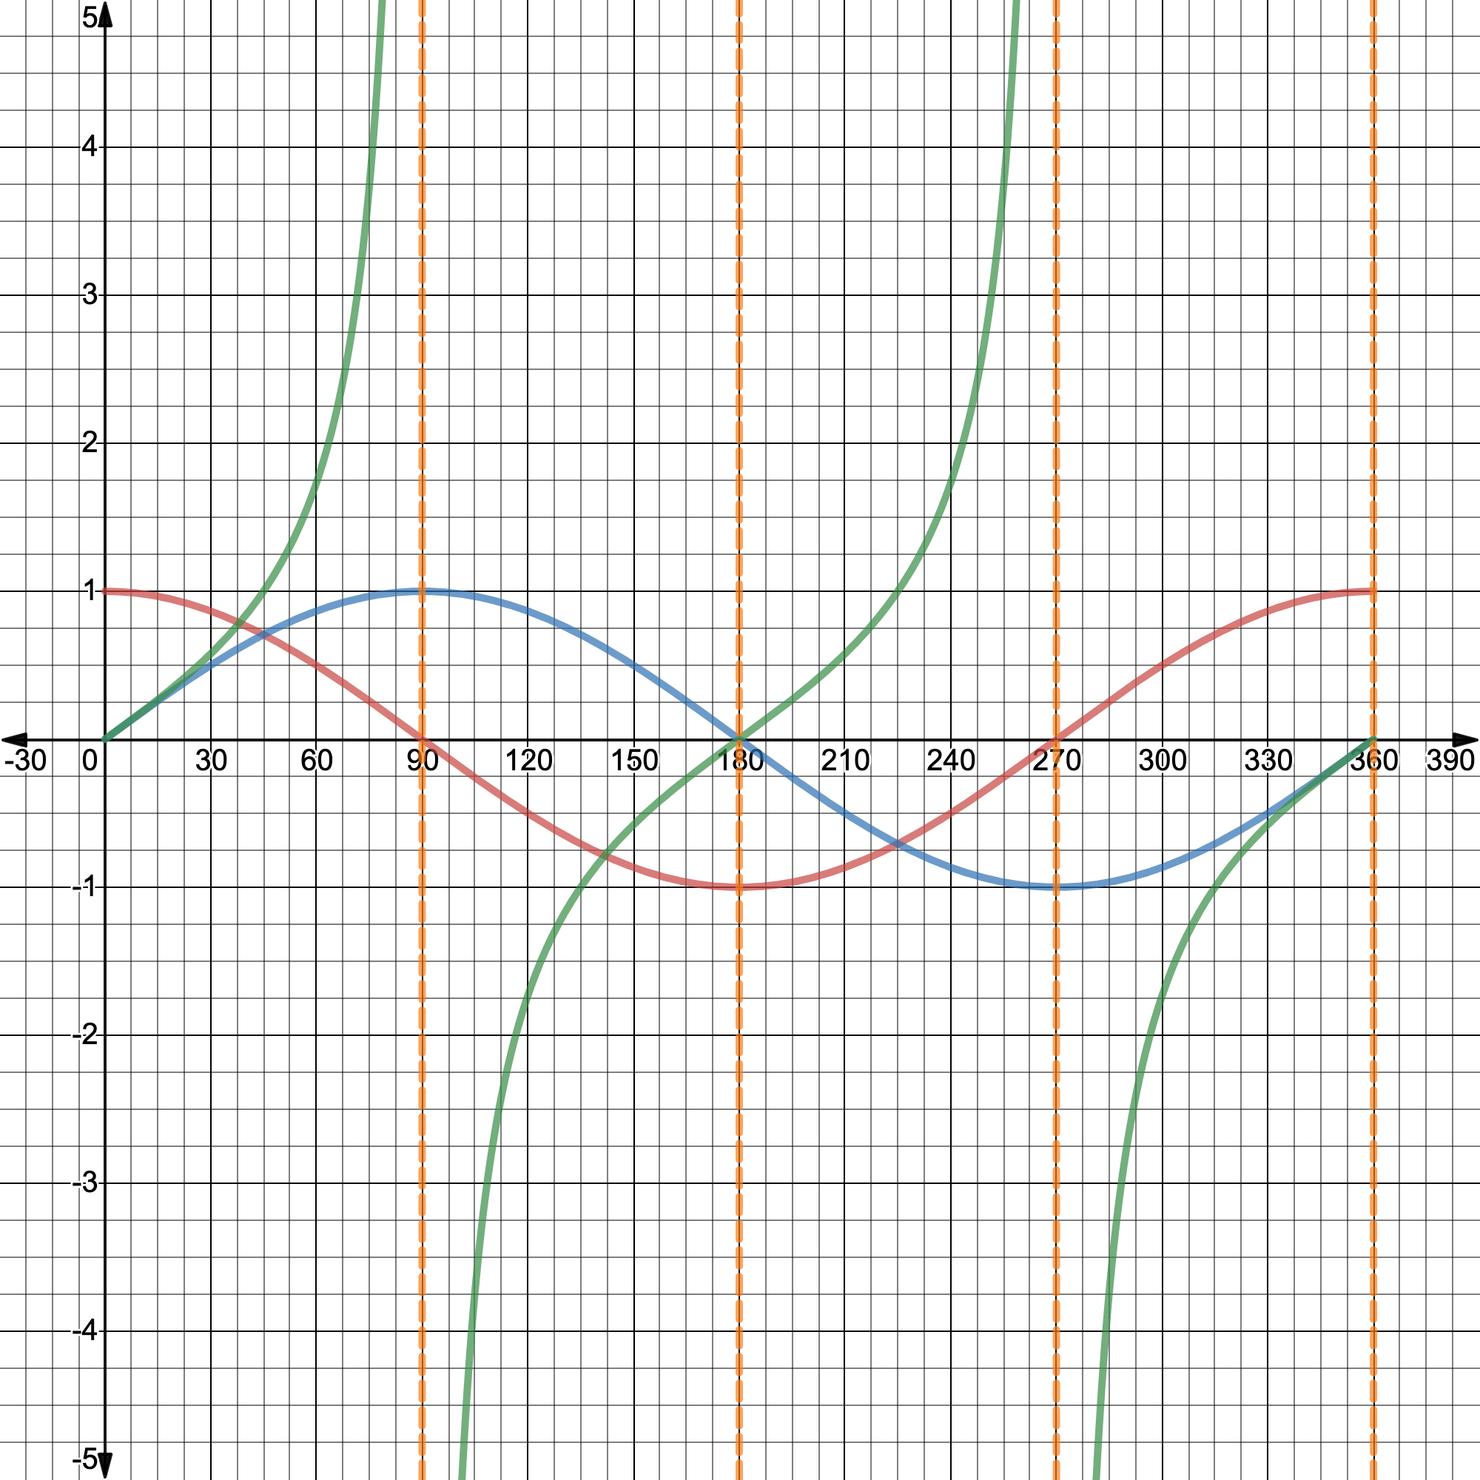
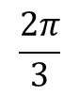
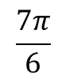

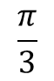
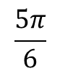
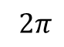
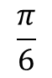
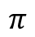
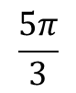
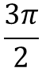
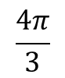
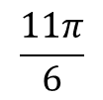
$$\frac{π}{6}$$
$$\frac{π}{3}$$
$$\frac{π}{2}$$
$$\frac{2π}{3}$$
$$\frac{5π}{6}$$
$$\frac{7π}{6}$$
$$\frac{4π}{3}$$
$$\frac{3π}{2}$$
$$\frac{5π}{3}$$
$$\frac{11π}{6}$$
$2π$
$$π$$

Slide 3
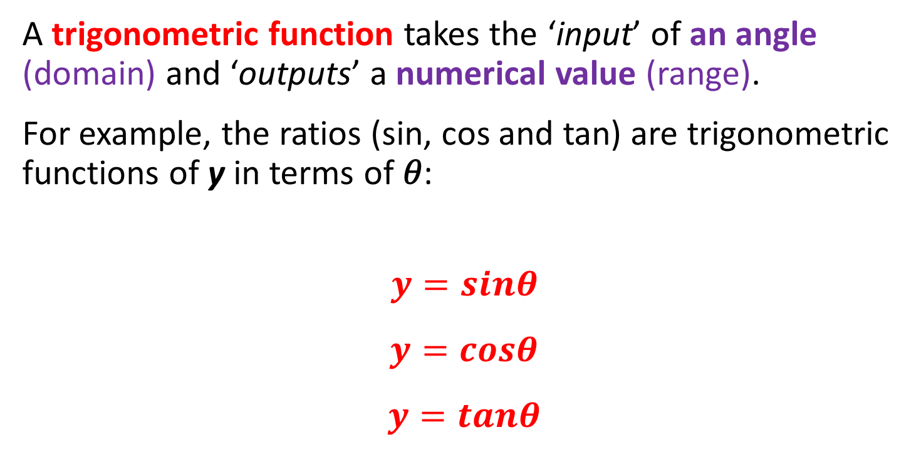
Trigonometric Functions (Periodic Functions)
Concept Development
A trigonometric function takes the ‘input’ of an angle (domain) and ‘outputs’ a numerical value (range).
For example, the ratios (sin, cos and tan) are trigonometric functions of y in terms of 𝜃:
$$y=sinθ$$
$$y=cosθ$$
$$y=tanθ$$

Slide 4
Features of Trigonometric (Periodic) Functions
Concept Development
There are two key features of any trigonometric (periodic) function:
Amplitude - the ‘height’ of the wave, from equilibrium to ‘crown’ (i.e the extrema). (The distance between the mean position and the maximum position)
Period - the angle required before the wave ‘repeats’.
Also thought of as the ‘time taken to repeat one cycle’.

Slide 5
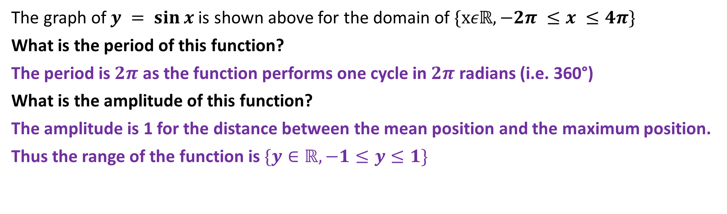
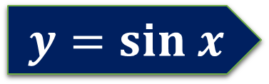
$$y=sin x$$
The graph of $y = sin⁡x$is shown above for the domain of $\{xεℝ,−2π ≤x ≤4π\}$
What is the period of this function?
The period is $2π$ as the function performs one cycle in $2π$ radians (i.e. 360°)
What is the amplitude of this function?
The amplitude is 1 for the distance between the mean position and the maximum position.
Thus the range of the function is $\{y∈ℝ,−1≤y≤1\}$

Slide 6
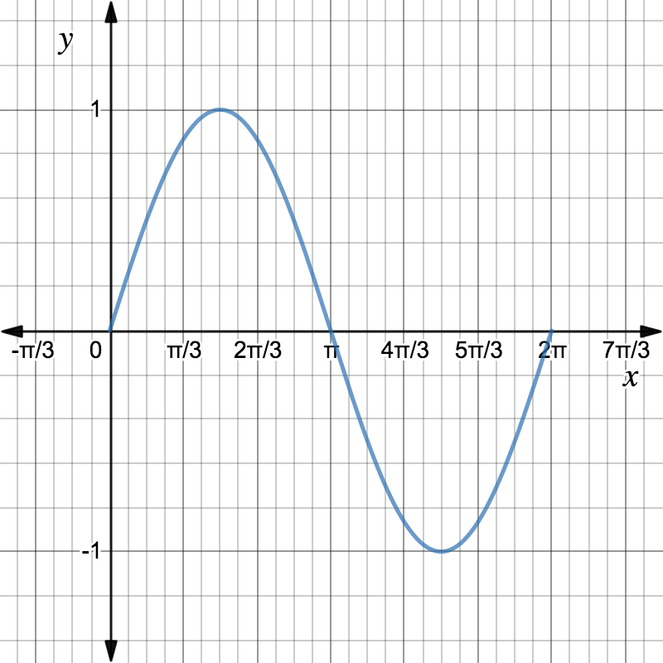
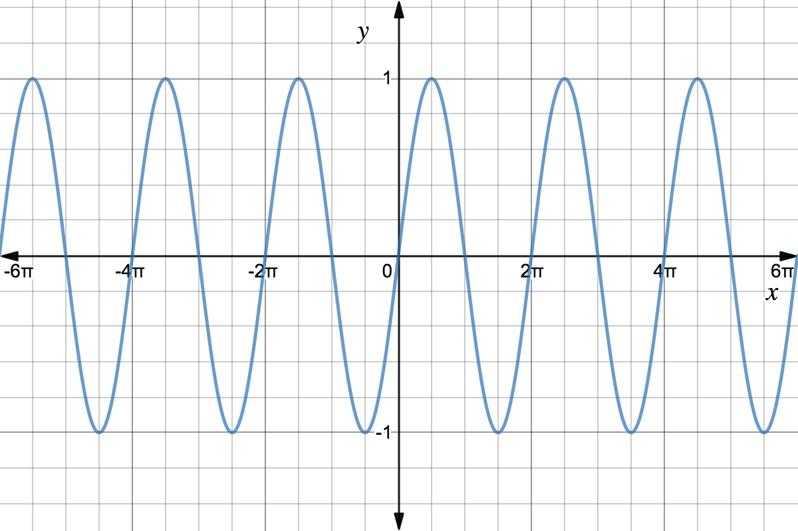
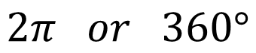

Features of the Sine Function
Concept Development
Amplitude
Period
$$1$$
$$2π or 360°$$

Slide 7
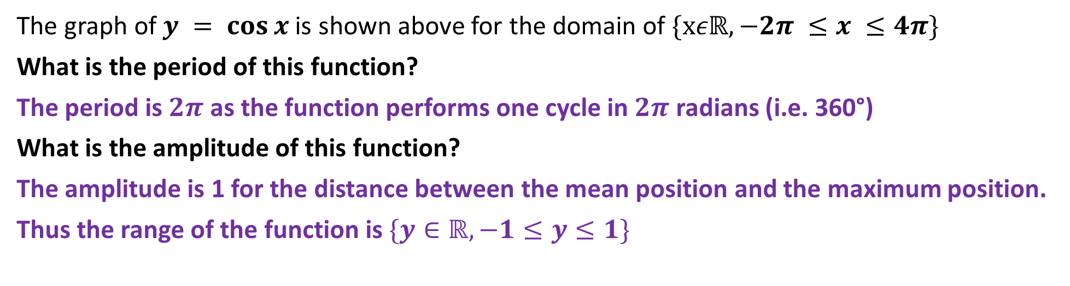
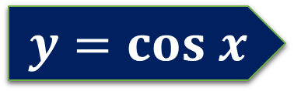
$$y=cos x$$
The graph of $y = cos⁡x$is shown above for the domain of $\{xεℝ,−2π ≤x ≤4π\}$
What is the period of this function?
The period is $2π$ as the function performs one cycle in $2π$ radians (i.e. 360°)
What is the amplitude of this function?
The amplitude is 1 for the distance between the mean position and the maximum position.
Thus the range of the function is $\{y∈ℝ,−1≤y≤1\}$

Slide 8
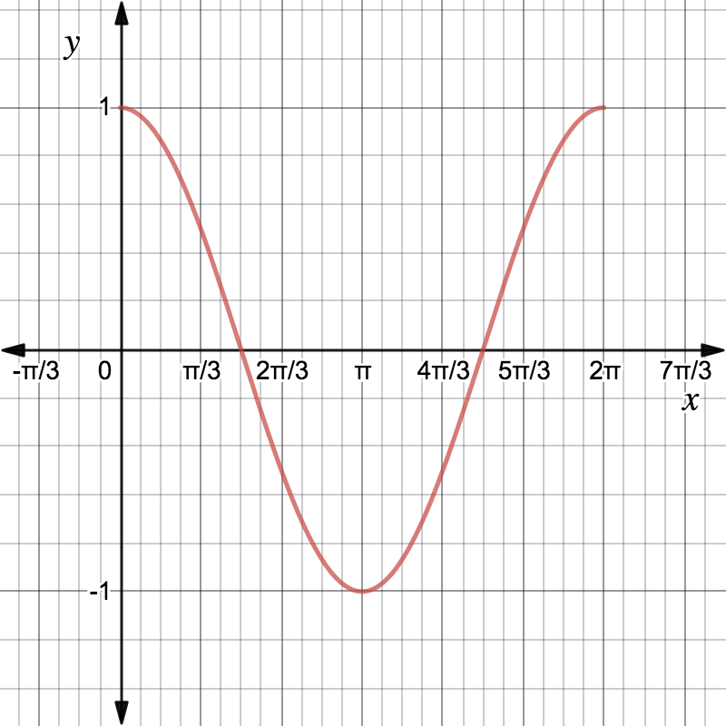
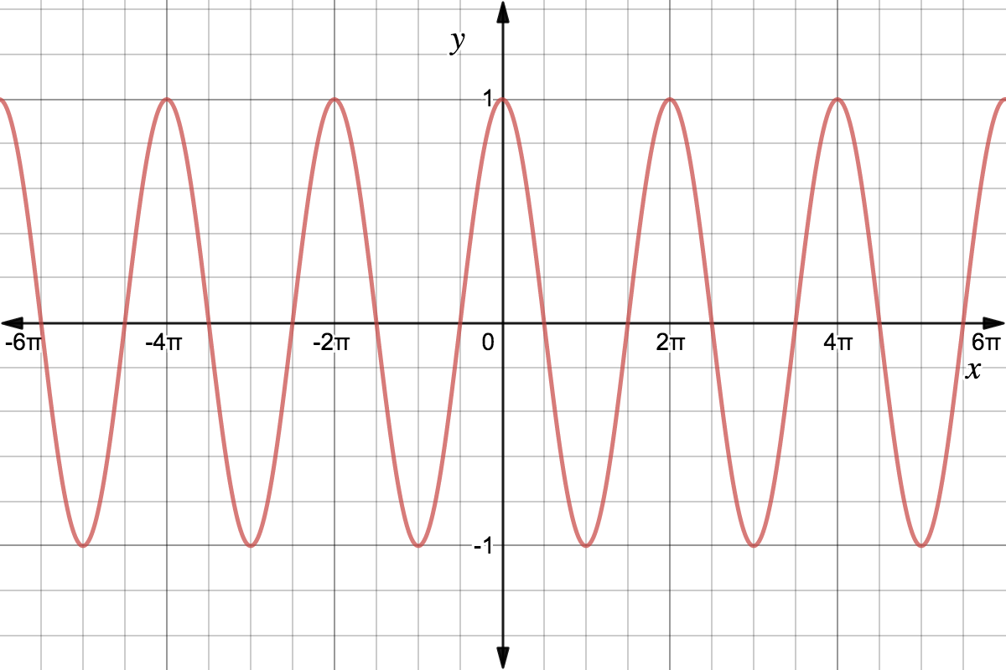
Features of the Cosine Function
Concept Development
Amplitude
Period
$$1$$
$$2π or 360°$$

Slide 9
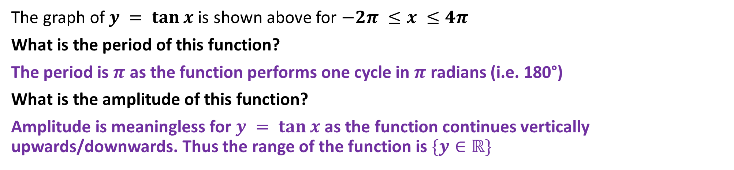
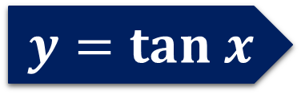
$$y=tan x$$
The graph of $y = tan⁡x$is shown above for $−2π ≤x ≤4π$
What is the period of this function?
The period is $π$ as the function performs one cycle in $π$ radians (i.e. 180°)
What is the amplitude of this function?
Amplitude is meaningless for $y = tan⁡x$as the function continues vertically upwards/downwards. Thus the range of the function is $\{y∈ℝ\}$

Slide 10
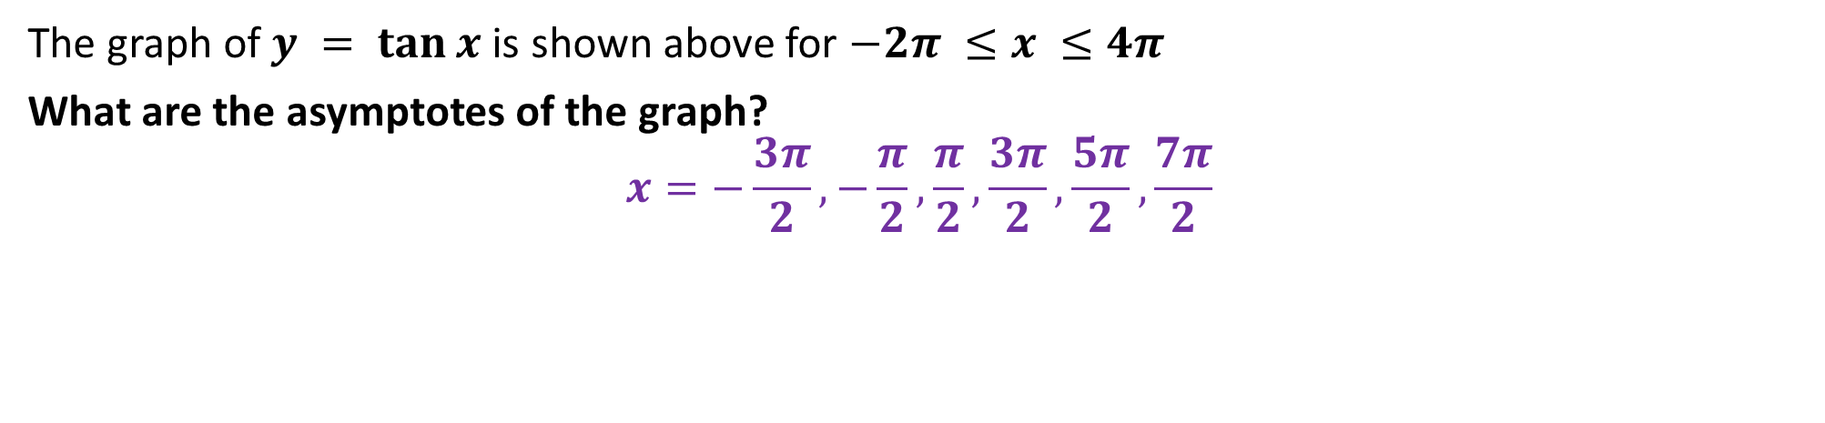
$$y=tan x$$
The graph of $y = tan⁡x$is shown above for $−2π ≤x ≤4π$
What are the asymptotes of the graph?
$$x=−\frac{3π}{2}, −\frac{π}{2},\frac{π}{2},\frac{3π}{2},\frac{5π}{2}, \frac{7π}{2}$$

Slide 11
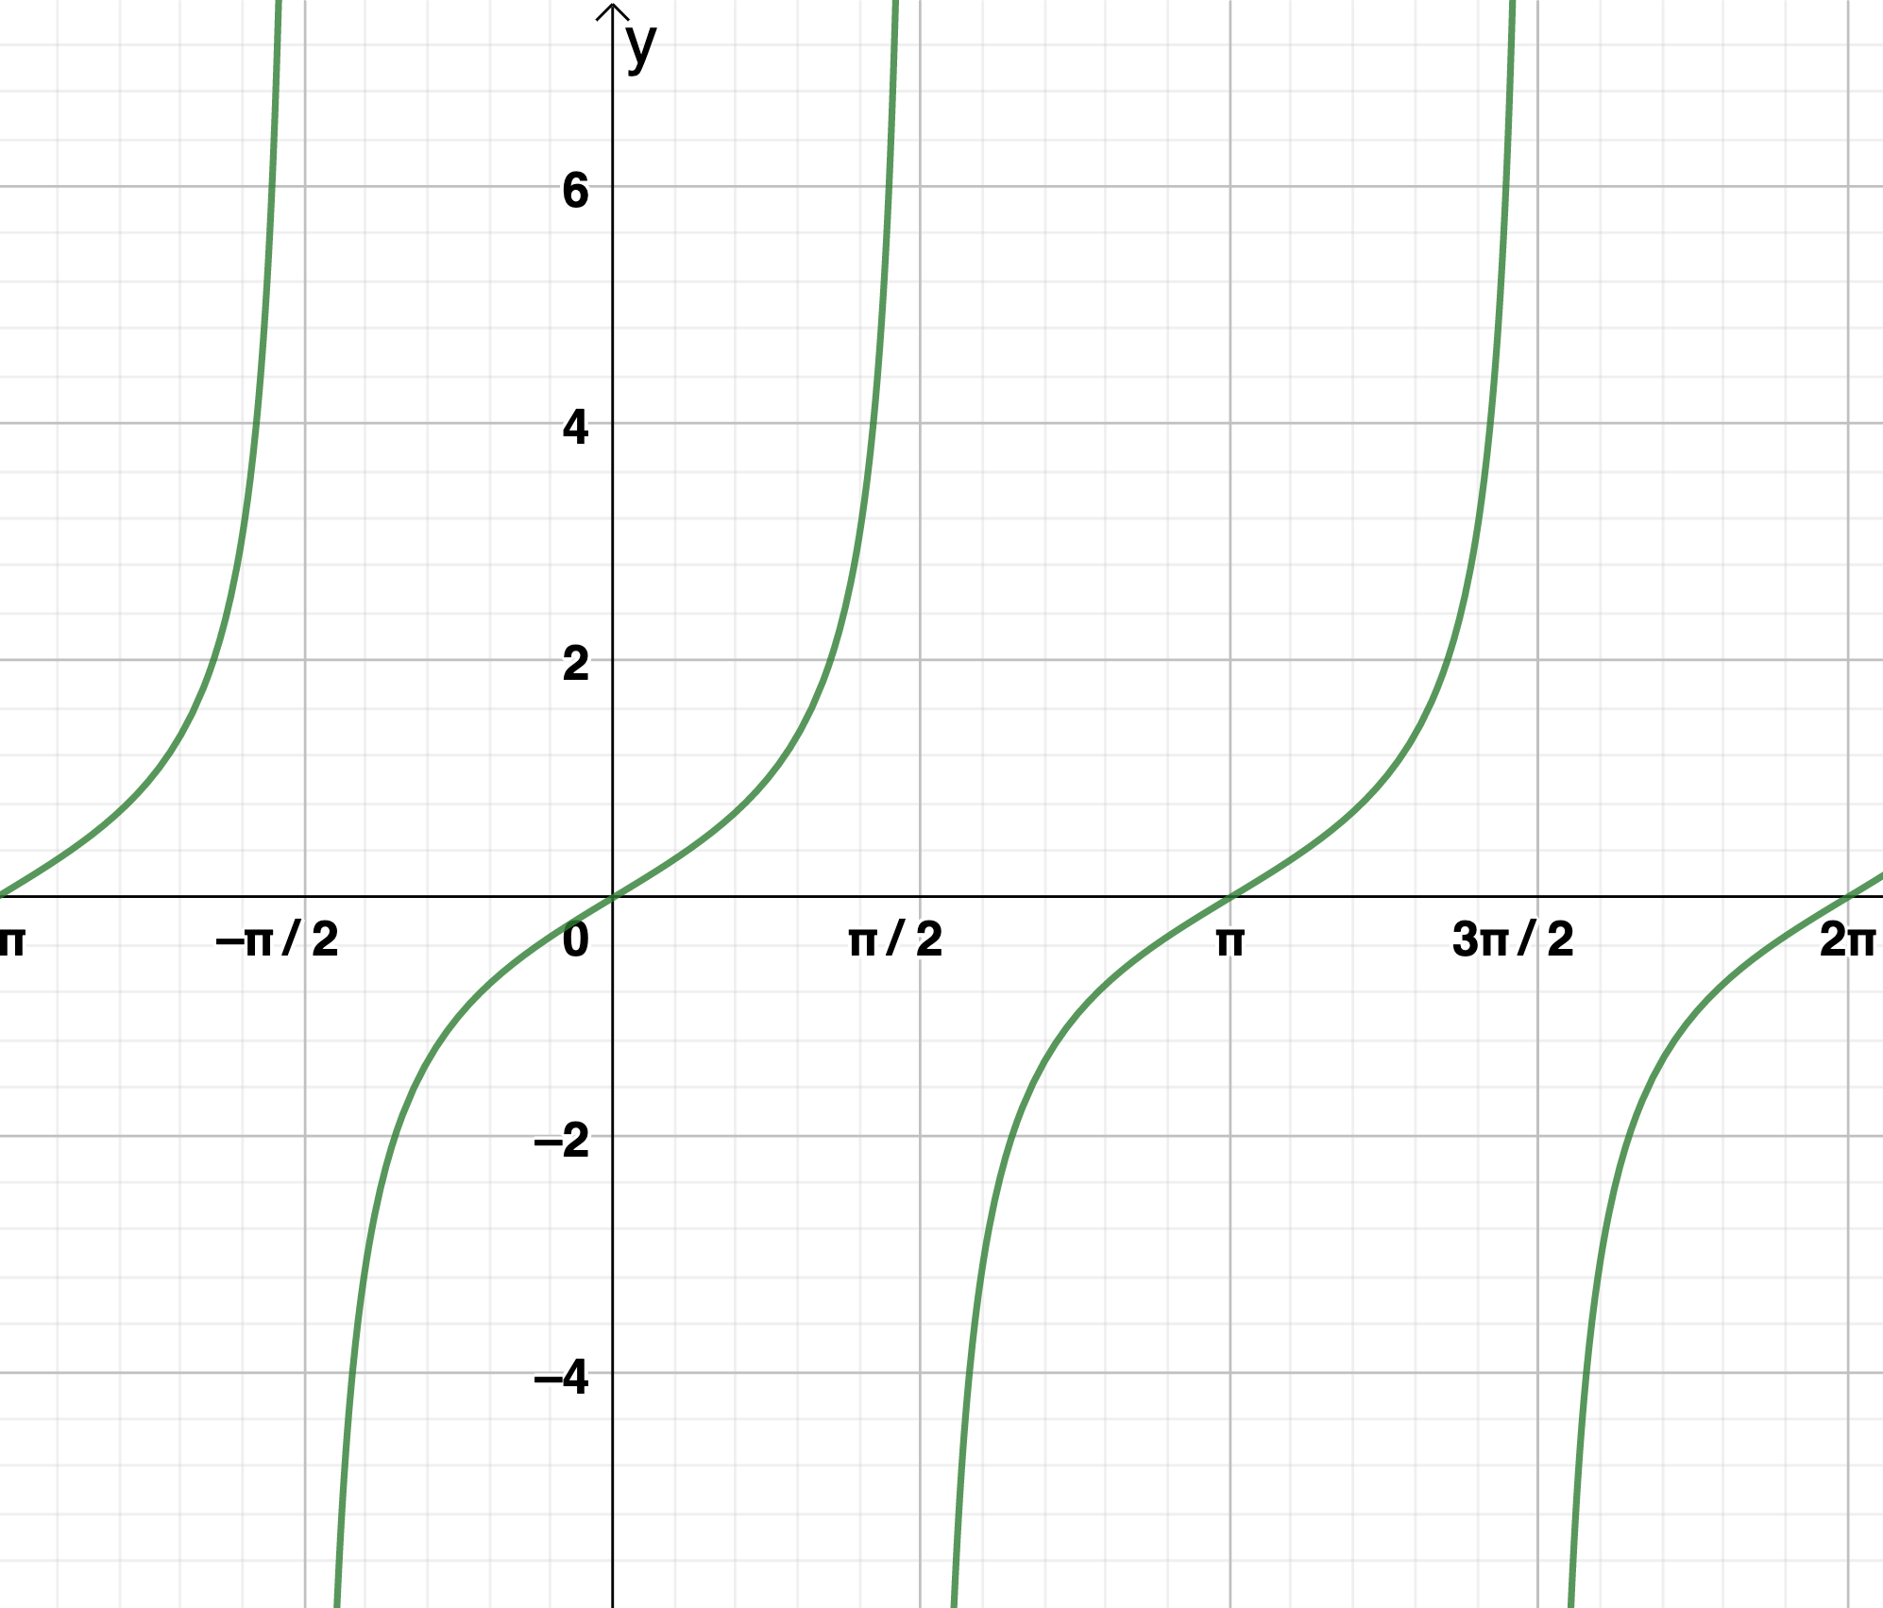
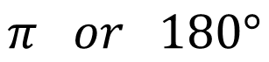

Features of the Tangent Function
Concept Development
Amplitude
Period
$$NA$$
$$π or 180°$$

Slide 12
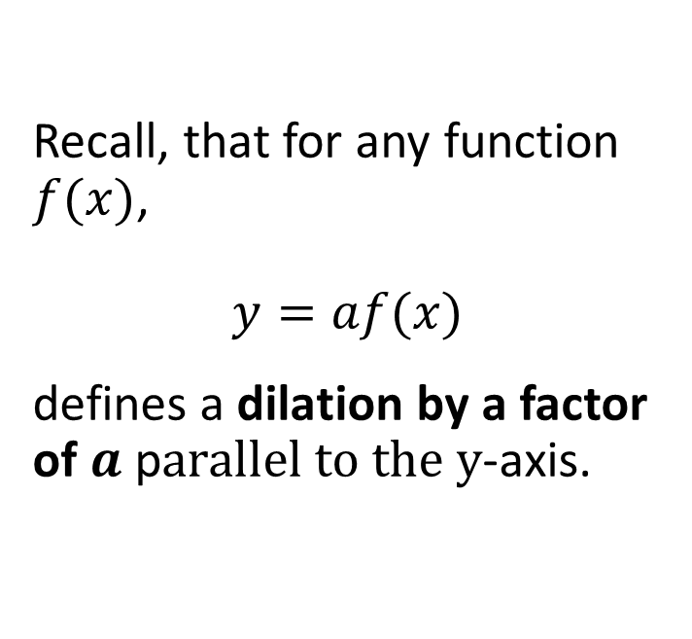
Dilation parallel to the y-axis (a)
Concept Development
Recall, that for any function $f(x)$,
$$y=af(x)$$
defines a dilation by a factor of $a$ p$arallel to the y$-axis.

Slide 13
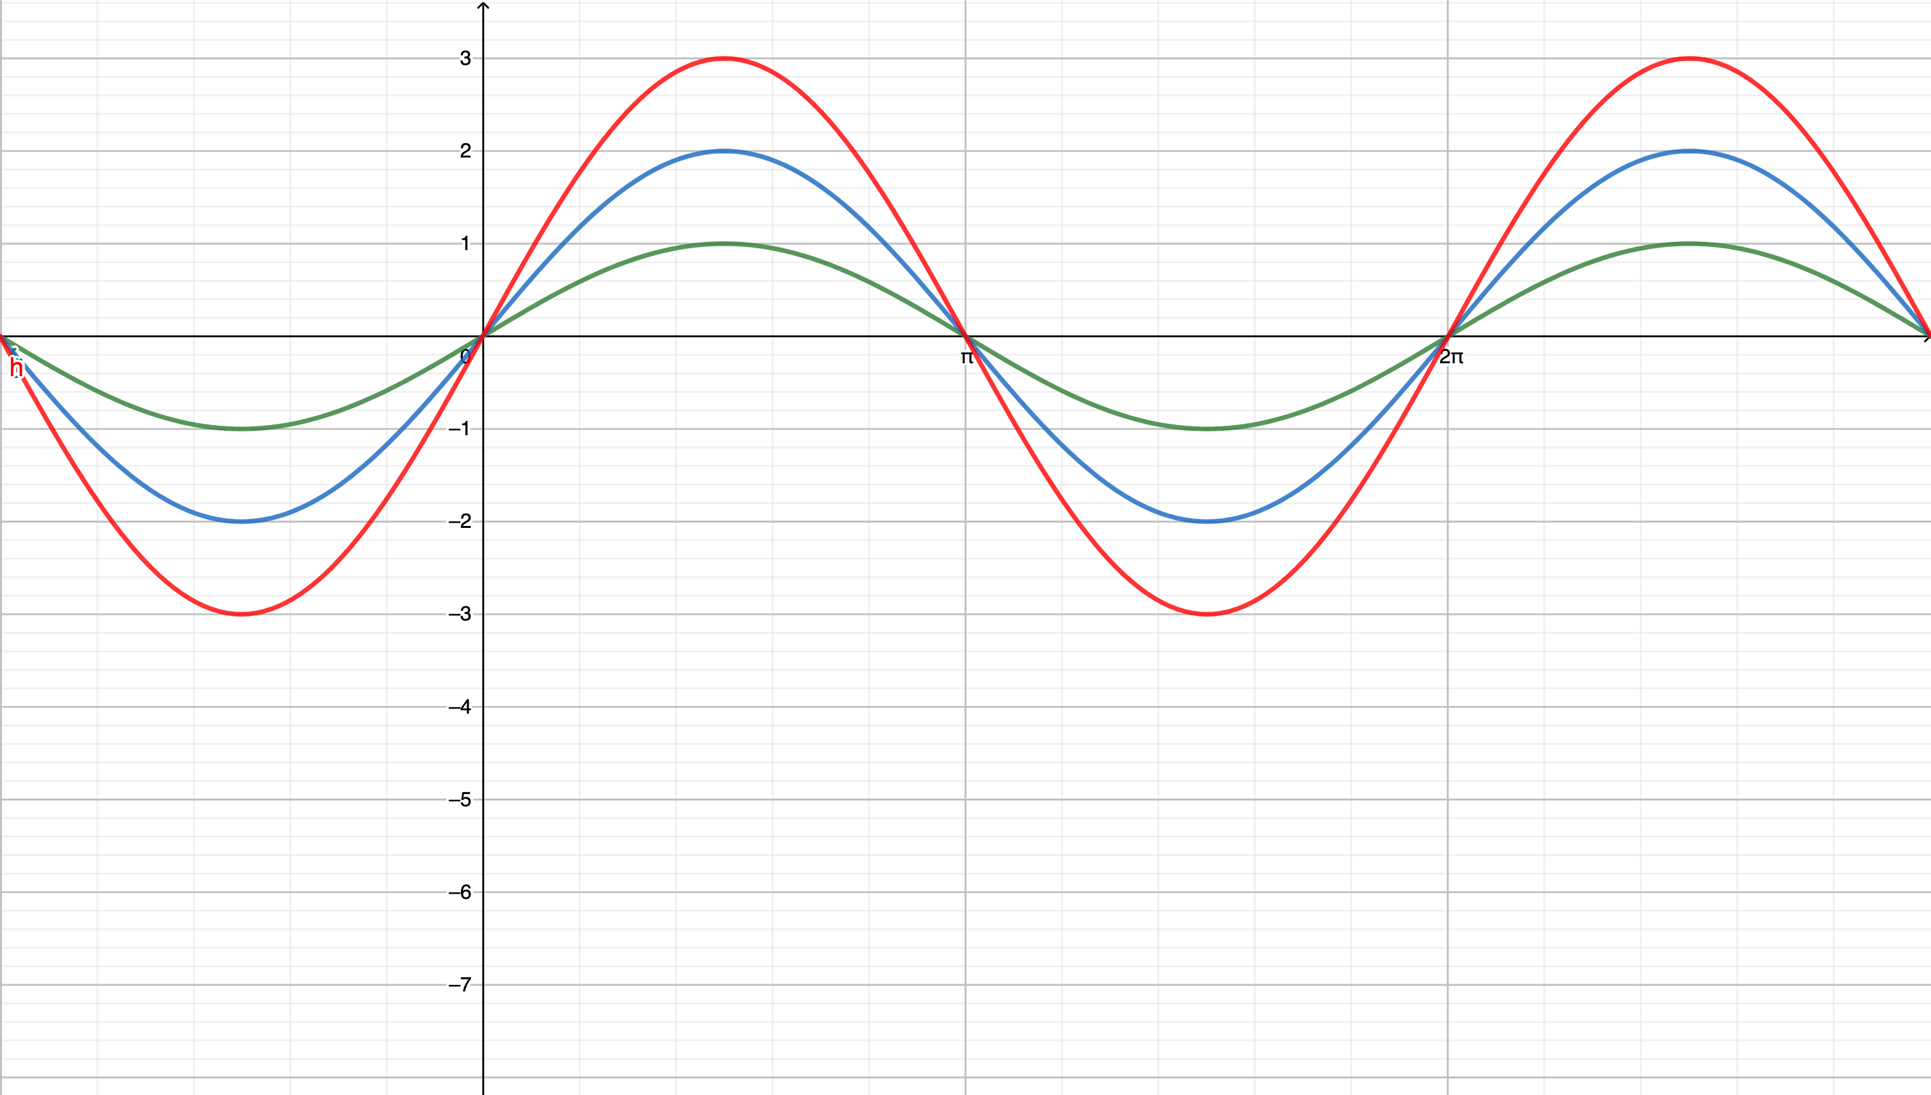

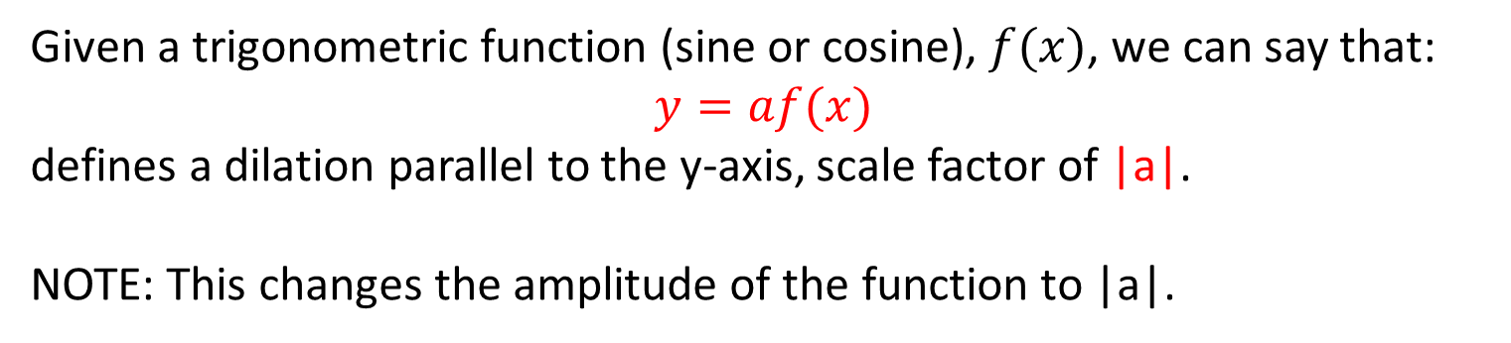
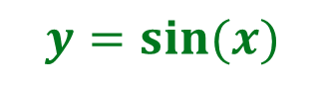
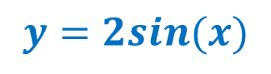
Concept Development
Change in Amplitude - (A dilation parallel to $y$-axis)
$$y=3sin⁡(x)$$
$$y=sin⁡(x)$$
$$y=2sin⁡(x)$$
Given a trigonometric function (sine or cosine), $f(x)$, we can say that:
$$y=af(x)$$
defines a dilation parallel to the y-axis, scale factor of |a|.
NOTE: This changes the amplitude of the function to |a|.

Slide 14
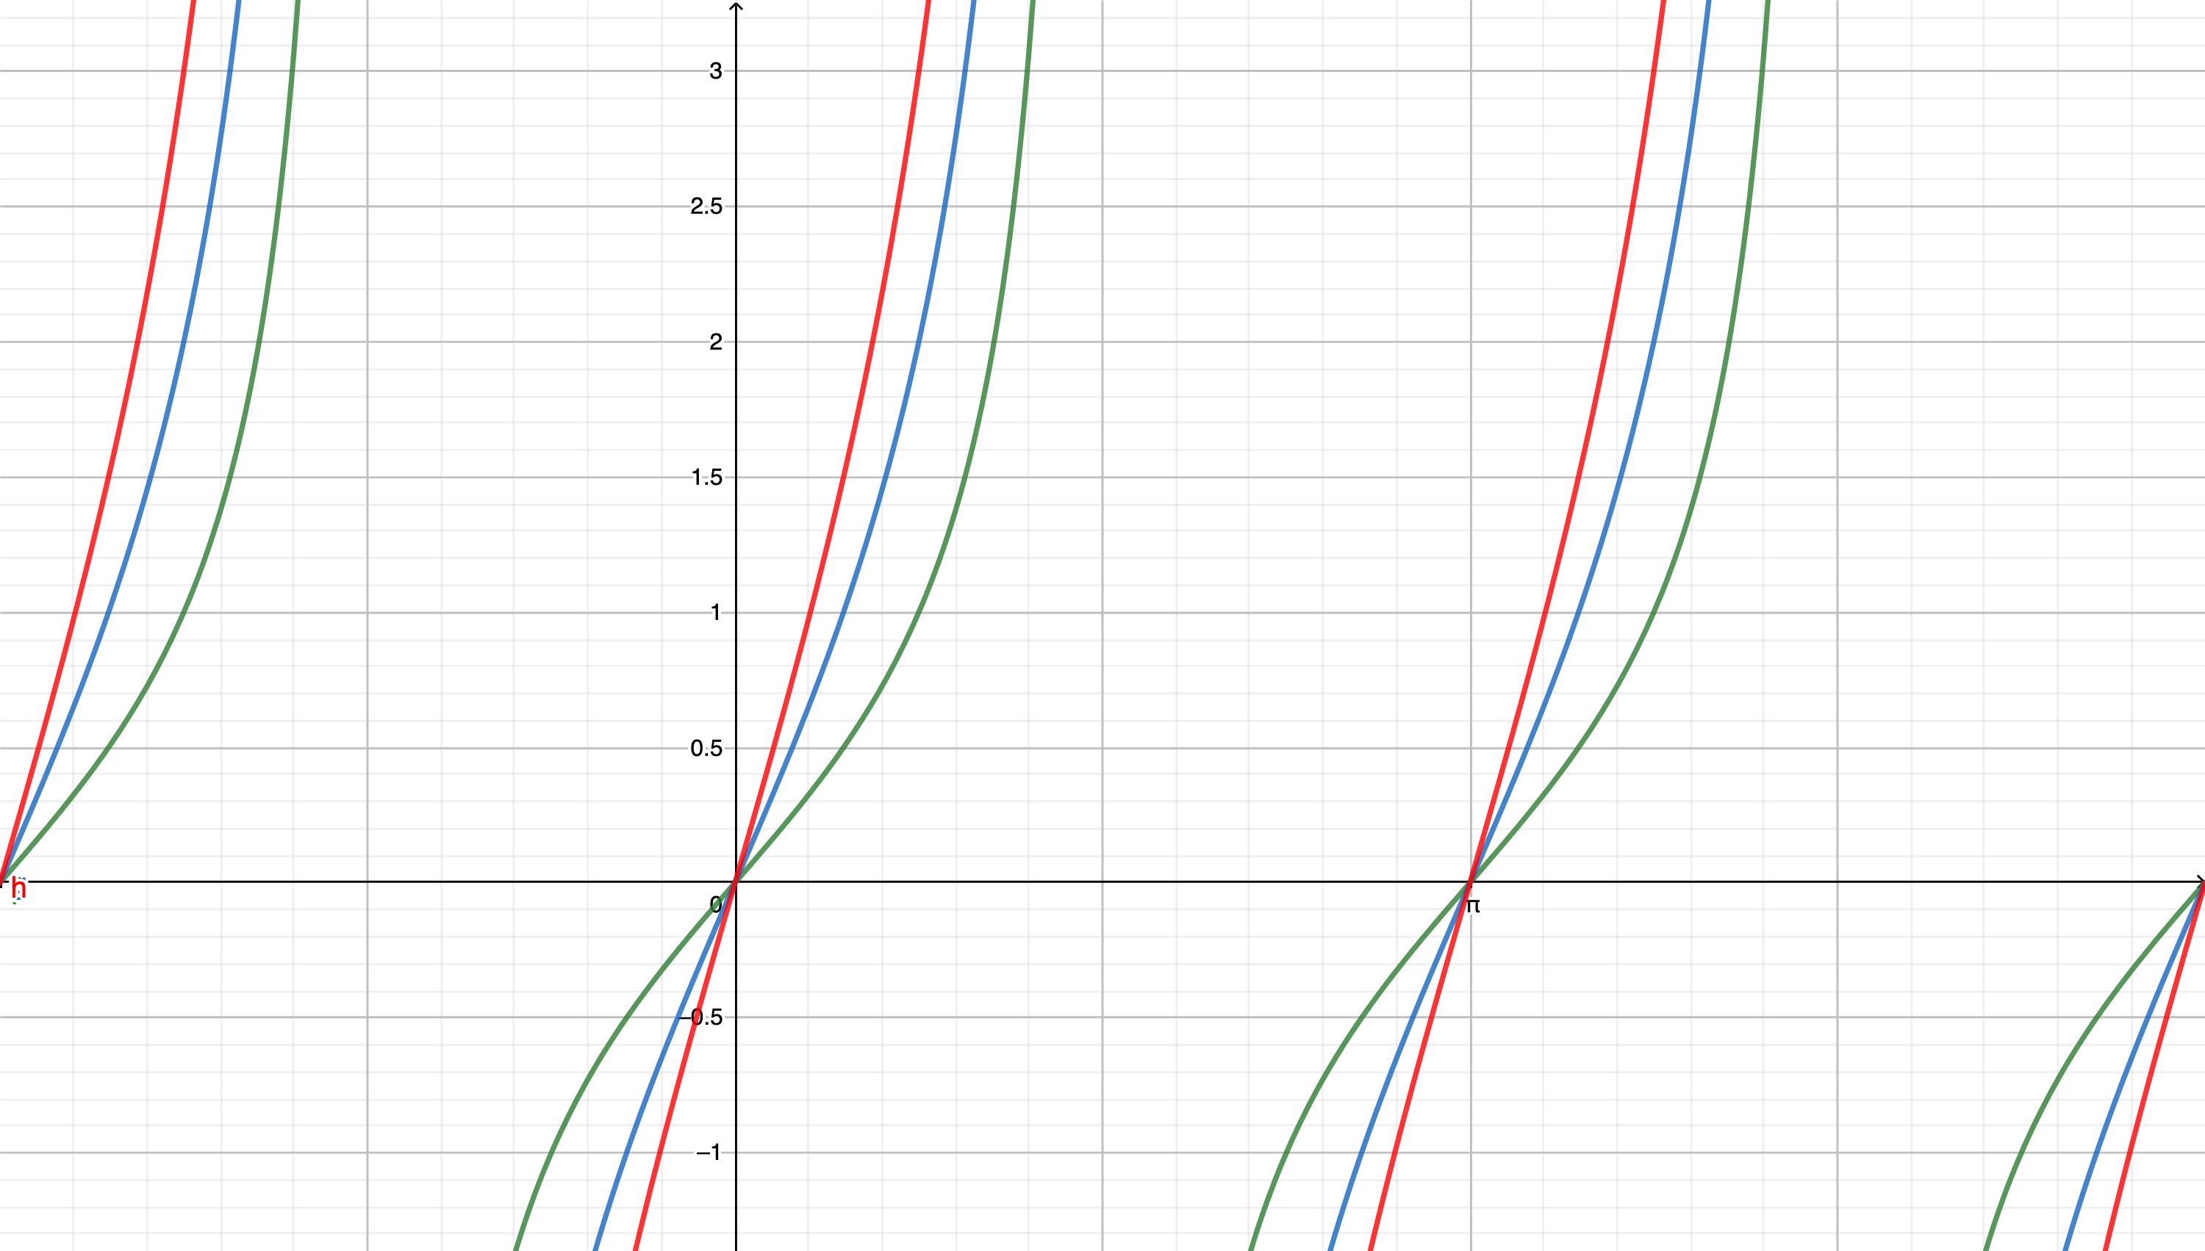
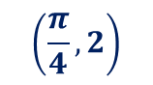
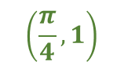

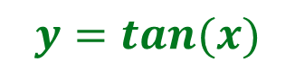
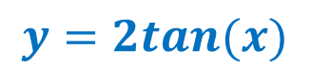

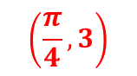
What about $y=\tan{(x)}$
Concept Development
$$y=3tan⁡(x)$$
$$\left(\frac{π}{4},3\right)$$
$$\left(\frac{π}{4},2\right)$$
$$y=2tan⁡(x)$$
$$\left(\frac{π}{4},1\right)$$
$$y=tan⁡(x)$$

Slide 15
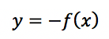
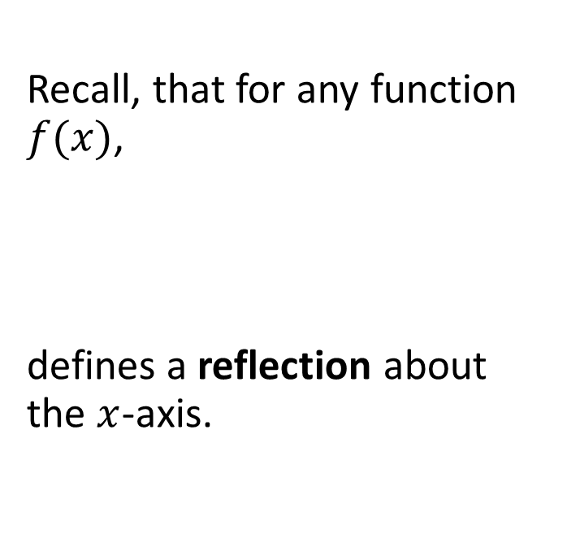
Reflection about the x-axis (a = -1)
Concept Development
Recall, that for any function $f(x)$,
defines a reflection about the $x$-axis.

Slide 16
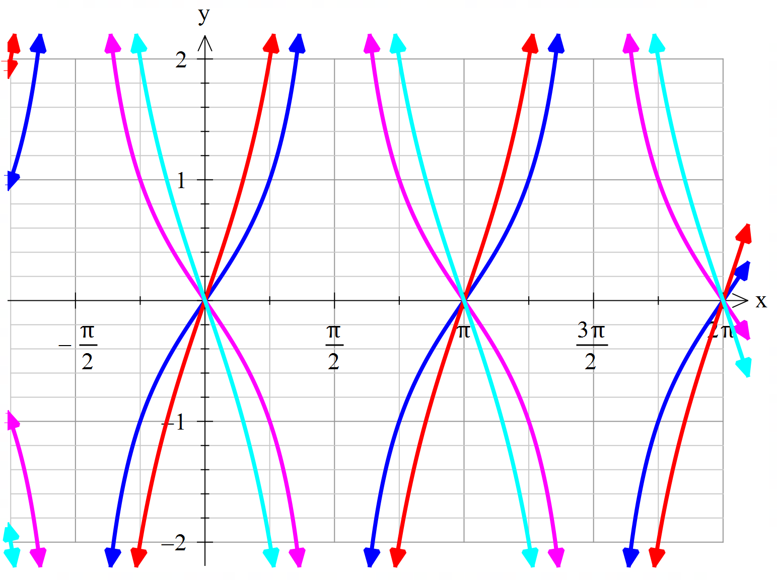

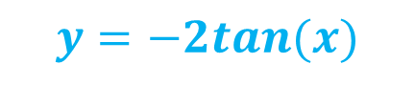


Concept Development
$$y=tan⁡(x)$$
$$y=2tan⁡(x)$$
$$y=−tan⁡(x)$$
$$y=−2tan⁡(x)$$

Slide 17
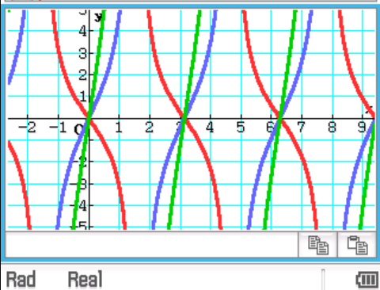
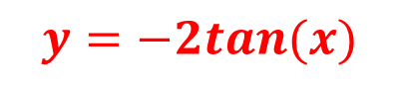

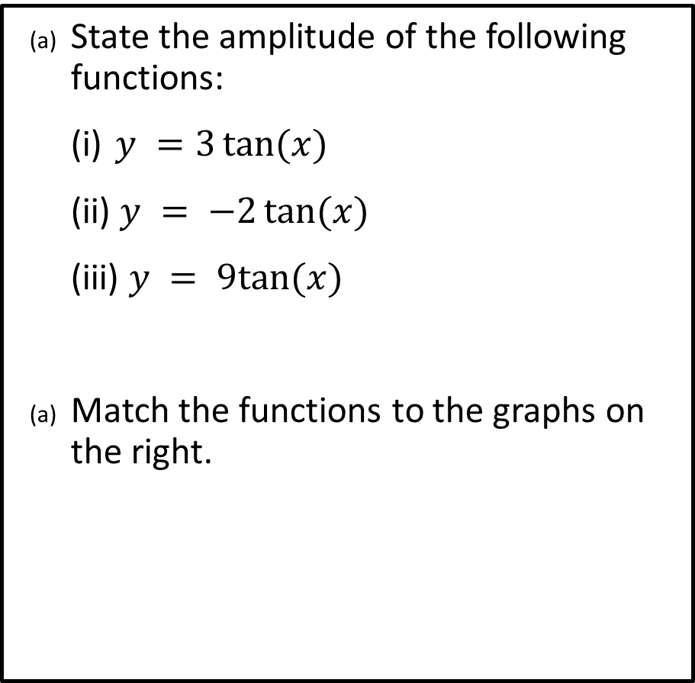




Guided Practice
$$y=3tan(x)$$
State the amplitude of the following functions:
(i) $y =3\tan{(x)}⁡$
(ii) $y = −2\tan{(x)}$
(iii) $y = 9tan⁡(x)$
Match the functions to the graphs on the right.
$$3$$
$$2$$
$$9$$
$$y=−2tan(x)$$
$$y=9tan(x)$$

Slide 18
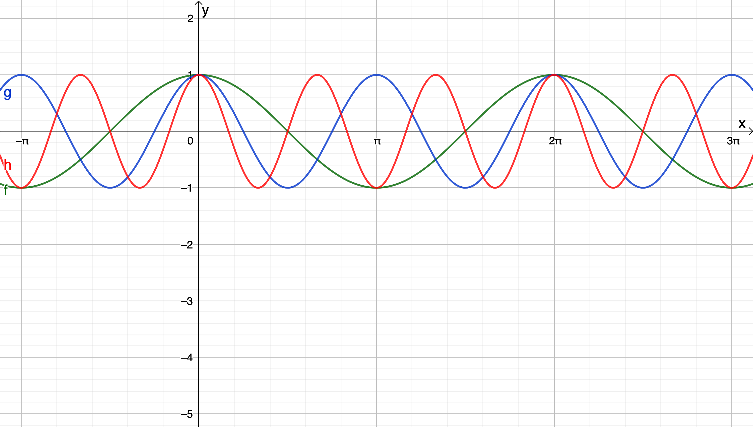
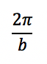

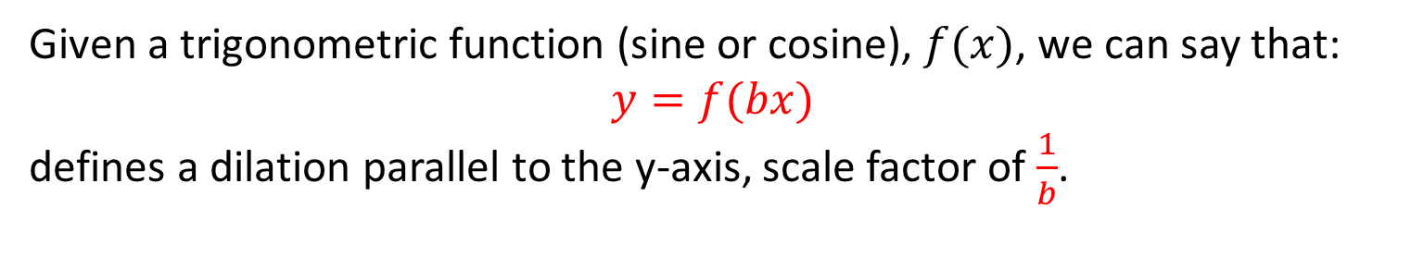
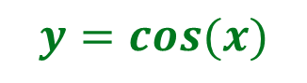
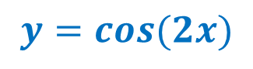
Period of sin(bx) and cos(bx) functions:
Concept Development
Change in Period - (A dilation parallel to $x$-axis)
$$y=cos(x)$$
$$y=cos⁡(3x)$$
$$y=cos⁡(2x)$$
Given a trigonometric function (sine or cosine), $f(x)$, we can say that:
$$y=f(bx)$$
defines a dilation parallel to the y-axis, scale factor of $\frac{1}{b}$.

Slide 19






Period of tan(bx) functions: $\frac{π}{b}$
Concept Development
Change in Period - (A dilation parallel to $x$-axis)
$$y=tan(x)$$
$$y=tan⁡(2x)$$
Given a trigonometric function (tan), $f(x)$, we can say that:
$$y=f(bx)$$
defines a dilation parallel to the y-axis, scale factor of $\frac{1}{b}$.
$$y=tan(\frac{1}{2}x)$$

Slide 20


Summary Part 1
Given a trigonometric function (tangent), $f(x)$
$$y=af\left(bx\right)$$
$$y=a\tan{(bx)}$$
The amplitude is $a$
If $a>1$, the transformation is: a dilation parallel to the $y−$axis by a factor of $a$
If $a<0$, the transformation is: a reflection about the x$−$axis
The period is $\frac{π}{b}$
The transformation is: a dilation parallel to the $x−$axis by a factor of $\frac{1}{b}$
The asymptotes are: $\frac{kπ}{b}+\frac{π}{2b}, k$ is an integer
The domain is $\left\{x∈ℝ,x≠\frac{kπ}{b}+\frac{π}{2b}, k∈ℤ\right\}$
The range is $\left\{y∈ℝ, −a≤y≤a\right\}$

Slide 21

Vertical Translation
Concept Development
Recall, that for any function f(x),
$$y=f\left(x\right)+d$$
defines a vertical translation, $d$ units in the direction of the +/- $y$-axis.
NOTE: Think of this transformation as a ‘change of equilibrium’.
If d > 0, “up”
If d < 0, “down”

Slide 22
Skill Development
Sketching tangent graph, $f:\left[m,n\right]→ ℝ, f\left(x\right)=a\tan{b\left(x±c\right)±d}$
Step 1: Determine starting point of graph, $f(m)$
Step 2: Determine ending point of graph, $f(n)$
Step 3: Determine amplitude $=a$,
Step 4: Determine period $=\frac{π}{b}$, informs how many cycles of the graph per the domain given.
Step 5: Determine the asymptote, $\frac{kπ}{b}+\frac{π}{2b}, k$ is an integer
Step 6: Determine $y−$intercept , substitute $x=0$ to determine $f(0)$
Step 7: Determine $x−$intercept , substitute $f(x)=0$, obtain new domain to suit period change and solve for $x$
Step 8: Sketch the graph showing start and end coordinates, turning points, $y−$intercept and $x−$intercept

Slide 23







On the axes provided, sketch the following over the domain 0 ≤ x ≤ 2𝜋. Determine the period and asymptotes.
Guided Practice
$$y =3 tan⁡(2x)$$
Period = $\frac{π}{2}$
Starting: $f\left(0\right)=0$ Ending: $f\left(2π\right)=3\tan\left(4π\right)=0$
$y−int,x=0 ∴\left(0,0\right)$
Asymptote, $\left(\frac{kπ}{b}+\frac{π}{2b}\right),x=\frac{π}{4},\frac{3π}{4},\frac{5π}{4},\frac{7π}{4}$
$x−int:tan\left(2x\right)=0, 0≤2x≤4π$ $$2x=0,π,2π,3π,4π \\ x=0,\frac{π}{2},π,\frac{3π}{2},2π$$

Slide 24







On the axes provided, sketch the following over the domain 0 ≤ x ≤ 2𝜋. Determine the period and asymptotes.
Guided Practice
$$y =\tan\left(\frac{1}{2}x\right)+1$$
Period = $2π$
Starting: $f\left(0\right)=1$ Ending: $f\left(2π\right)=\tan\left(π\right)+1=1$
$y−int,x=0 ∴\left(0,1\right)$
$asymptote \left(\frac{kπ}{b}+\frac{π}{2b}=2kπ+π\right):π$
$x−int:tan\left(\frac{1}{2}x\right)=−1, 0≤\frac{x}{2}≤π$ $$2x=0,π,2π,3π,4π \\ x=0,\frac{π}{2},π,\frac{3π}{2},2π$$

Slide 25








Guided Practice
On the axes provided, sketch the following over the domain $−π≤x≤π$ Determine the period and asymptotes.
$$y =−tan⁡(x) − 2$$
Period = $π$ and reflected
Starting: $f\left(−π\right)=−2$ Ending: $f\left(π\right)=−2$
$y−int,x=0 ∴\left(0,−2\right)$
$asymptote \left(\frac{kπ}{b}+\frac{π}{2b}=kπ+\frac{π}{2}\right):−\frac{π}{2},\frac{π}{2}$
$Use classpad to solve for x−intercepts$

Slide 26
Independent Practice
Complete Cambridge Ex 12K

